Slide 1
Introduction to WOFRY
Transport of coherence in a beamline

Slide 2

Introduction to WOFRY
Transport of coherence in a Beamline
Manuel Sanchez del Rio
srio@esrf.eu
Advanced Analysis & Precision Unit, MEG/ISDD, ESRF
May 29th 2023
WOFRY

Slide 3
Transport of coherence in a Beamline
Outline:
Basics of Partial Coherence in SR
Introduction to Coherent Mode Decomposition with 2D and 1D wavefronts
What is WOFRY
Gallery of exercises and examples
Gallery of results

Slide 4
Basics

Slide 5
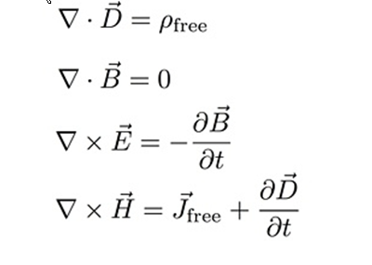
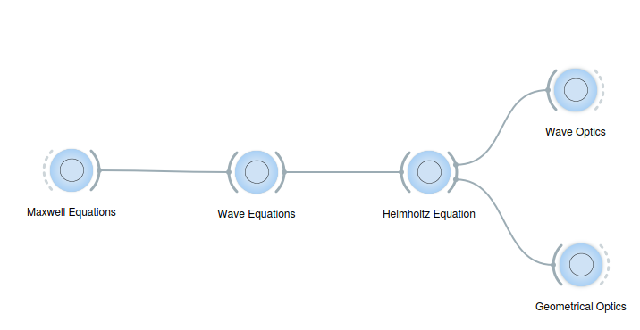
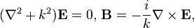
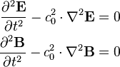
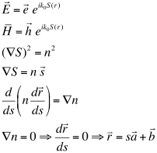
From theory to software: ALL ABOUT LIGHT
Wavefront
FULLY COHERENT:
A WAVEFRONT IS ALWAYS COHERENT
Rays
FULLY INCOHERENT:
A RAY IS A PLANE WAVEFRONT
THE RAYS DO NOT INTERFERE

Slide 6
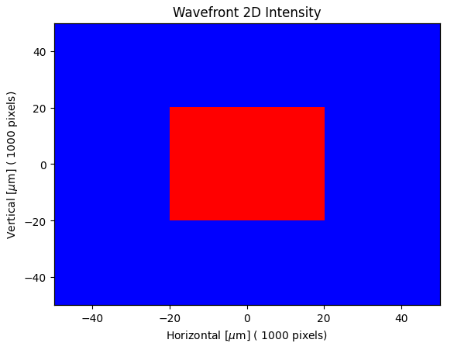
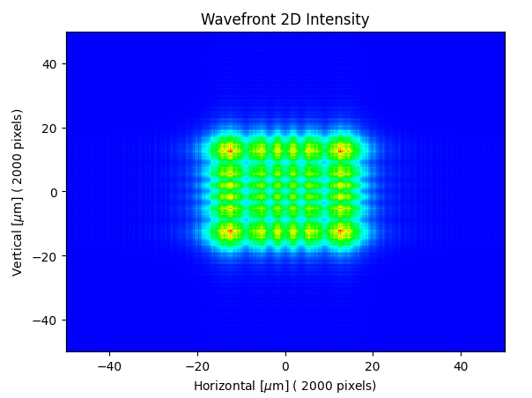
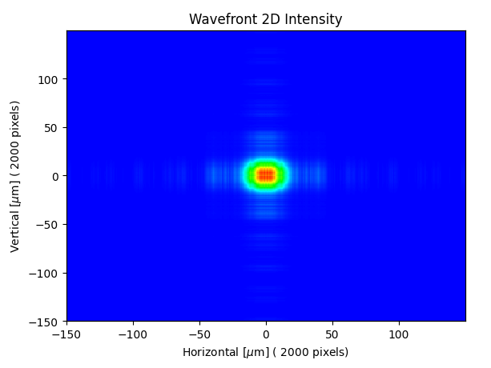
Coherence – Basic concepts
Ray tracing
1 m
15 m
Coherence: is the ability of a beam to be diffracted by objects (e.g. slits) producing a “diffraction pattern”
Diffraction pattern results from the interference of propagated electric fields

Slide 7
The electron emittance implies partial coherence
1 electron => Trajectory => Wavefront
Many identical electrons [filament beam] => Wavefront
Many non-identical electrons: multiple wavefronts

Slide 8
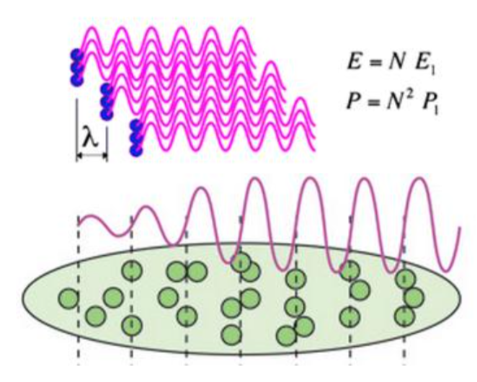
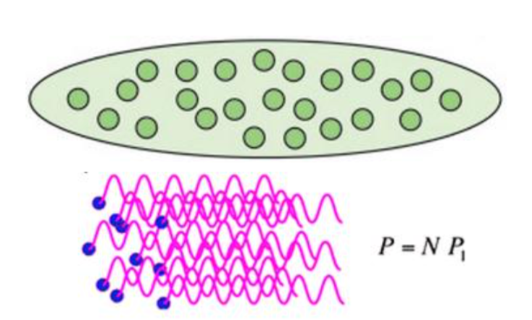
4th generation synchrotron sources
X-FEL
Bunch length ~ wavelength emitted so emission from different electrons add coherently – transversal (spatial) and longitudinal (time) coherence
Storage Ring
Bunch length >> wavelength so emission from electrons add incoherently.
Reduce the emittance from 3rd generation with the aim of becoming “diffraction limit” sources, i.e., natural emission << electron size. DLSR? Better ultra low emittance SR

Slide 9
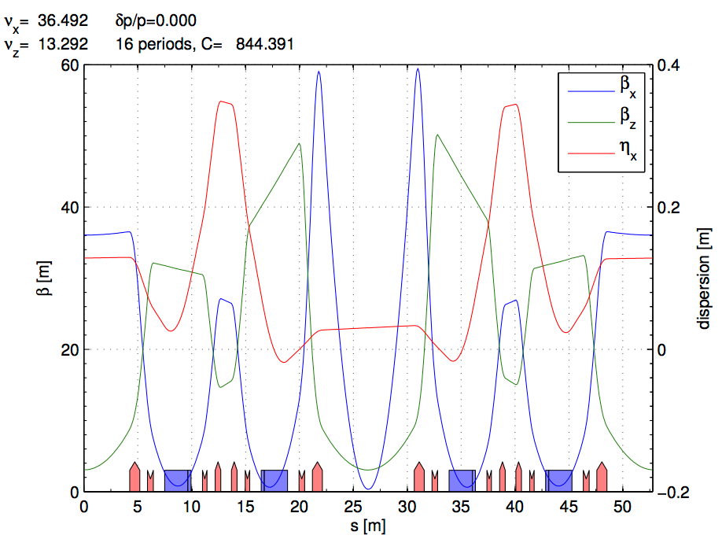
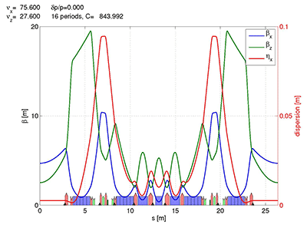
ESRF and EBS LATTICES
ESRF Double Bend Achromat (ESRF-1) -> Multi-bend achromat (EBS)
Horizontal emittance = 4000 pm Horizontal emittance = 137 pm
High Beta:
β_{x} = 37.59 m
β_{y} = 2.95 m
σ_{x} = 415.0 μm
σ_{y} = 3.43 μm
σ_{x’}= 10.3 μrad
σ_{z’}=1.16 μrad
Low Beta:
β_{x} = 0.35 m
β_{y} = 3.0 m
σ_{x} = 50.4 μm
σ_{y} = 3.44 μm
σ_{x’}= 107.2 μrad
σ_{z’}=1.16 μrad
EBS (S28D):
β_{x} = 6.90 m
β_{y} = 2.64 m
σ_{x} = 30.2 μm
σ_{y} = 3.64 μm
σ_{x’}= 4.37 μrad
σ_{z’}=1.37 μrad

Slide 10
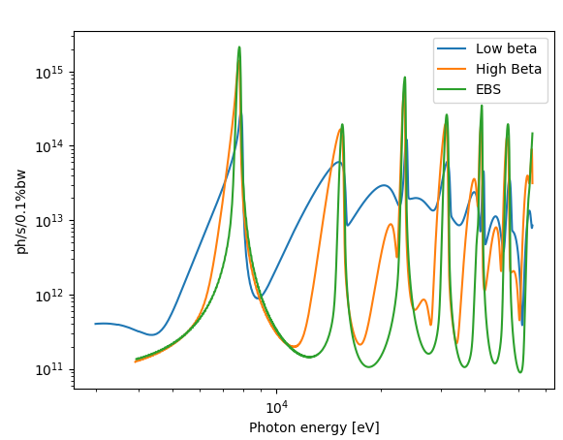
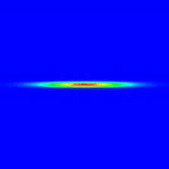
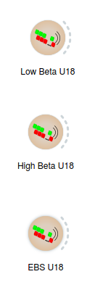
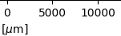
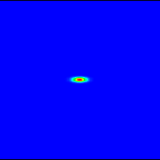
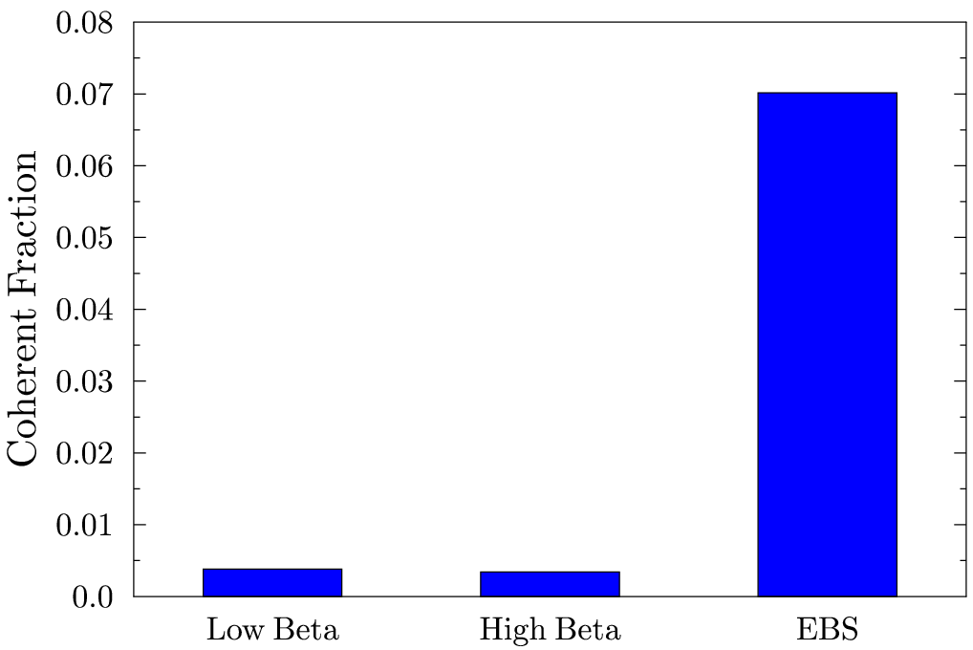
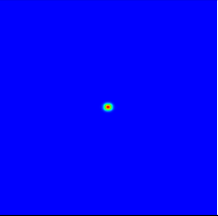
EBS – ESRF U18 2m @ 8 keV L=2m observed at 30m
Big increase of brightness and transverse coherence

Slide 11
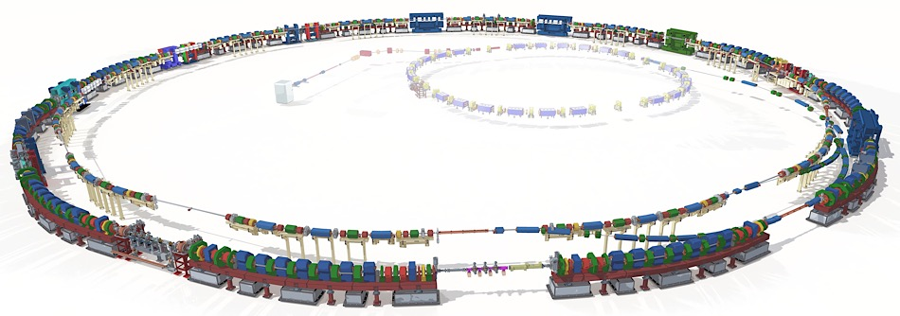
ALS-U
Electron Beam Profiles
Today’s ALS
Transfer lines
New full-length undulators optimized for high coherent flux
Linac
(existing)
Booster
(existing)
Future ALS
New 2.0 GeV accumulator ring for full-energy swap-out injection and recovery of bunch trains
New 2.0 GeV 9BA storage ring in existing tunnel optimized for low emittance and high soft x-ray brightness and coherent flux

Slide 12
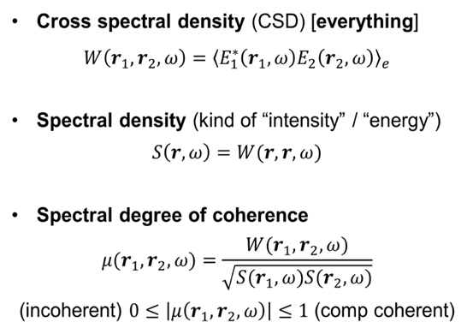
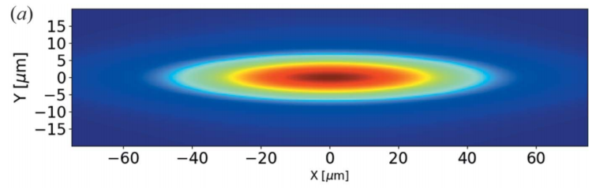
All we need is Cross Spectral Density
Coherent length
Can be defined
from some cuts

Slide 13
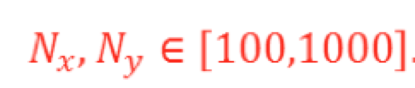
Coherent Mode Decomposition
10D function (3x3+1)
Fix E and z => 4D
Still W too big to calculate/store
W ~ 10⁸ – 10¹² (Gb-Tb)
Eigenvalues:
Weights or intensities
Eigenfunctions:
Modes
4D function
2D functions
Store: m x N x N; Propagate: 2D integrals
M Glass, M Sanchez del Rio, EPL Europhysics letters (2017)
http://dx.doi.org/10.1209/0295-5075/119/34004

Slide 14
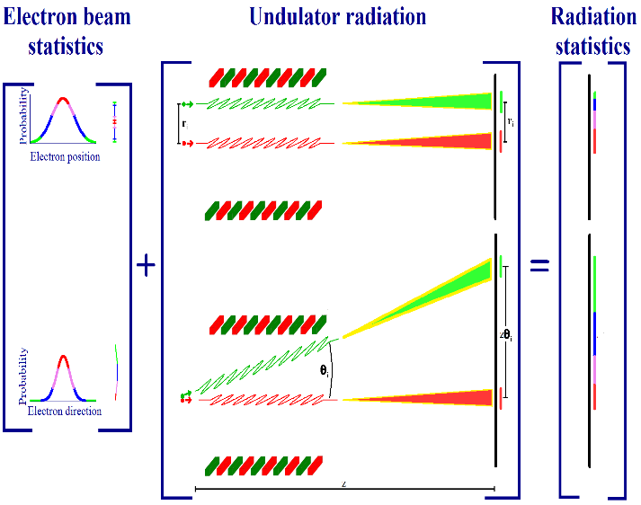
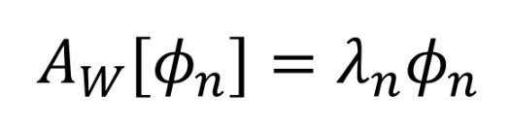
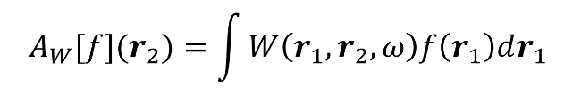
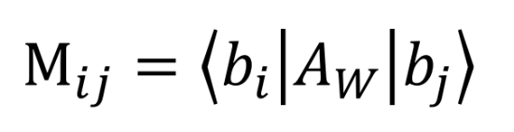
COMSYL (Coherent Modes for Synchrotron Light)
COMSYL https://github.com/mark-glass/comsyl
Calculate CSD
Coherent mode decomposition
K.-J. Kim Proc. SPIE 0582 (1986)
OASYS
Friedholm equation:
Propagate CSD along the beamline
Diagonalize M with iterative solver slepc
Large memory.
Parallel computers using MPI.
Large clusters (ESRF). Cloud computing (AWS, etc.)
Rediagonalize CSD

Slide 15
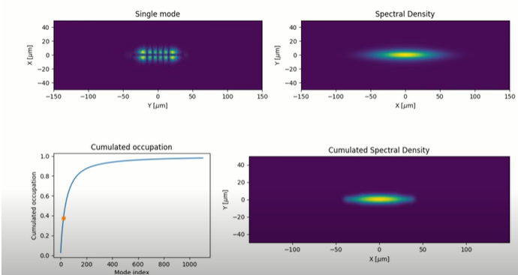
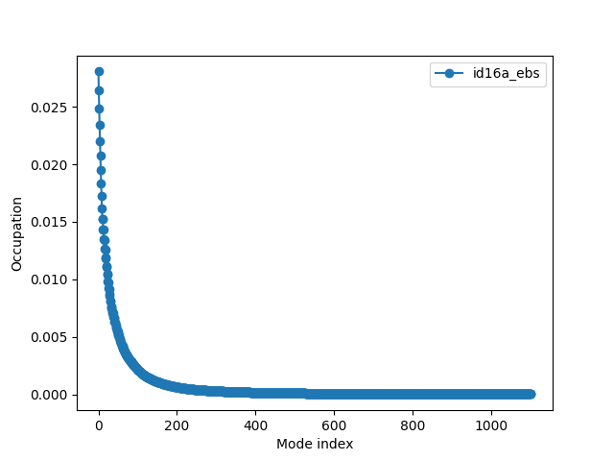
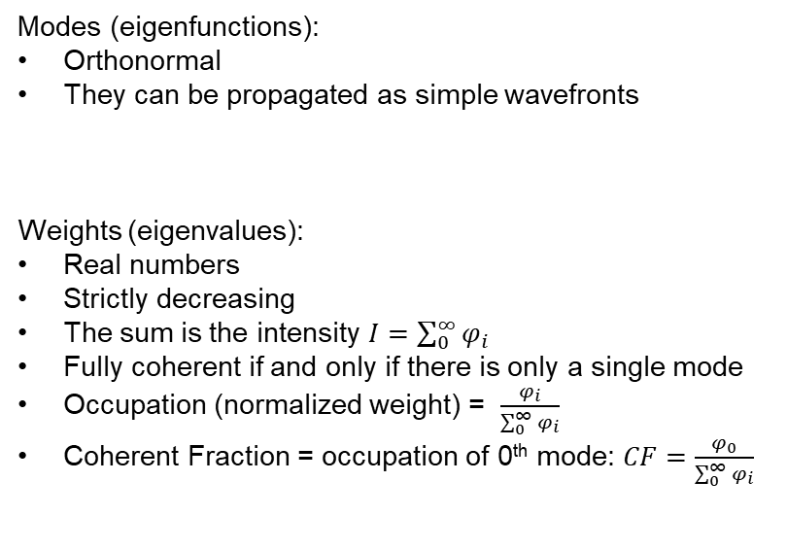
Benefits of Coherent Mode Decomposition
Modes (eigenfunctions):
Orthonormal
They can be propagated as simple wavefronts
Weights (eigenvalues):
Real numbers
Strictly decreasing
The sum is the intensity $I=\sum_{0}^{∞}{φ_{i}}$
Fully coherent if and only if there is only a single mode
Occupation (normalized weight) = $\frac{φ_{i}}{\sum_{0}^{∞}{φ_{i}}}$
Coherent Fraction = occupation of 0th mode: $CF=\frac{φ_{0}}{\sum_{0}^{∞}{φ_{i}}}$
https://youtu.be/h24RrJZaQ80
Coherent Fraction
EBS 2.8%
ESRF-EBS (17 keV)

Slide 16
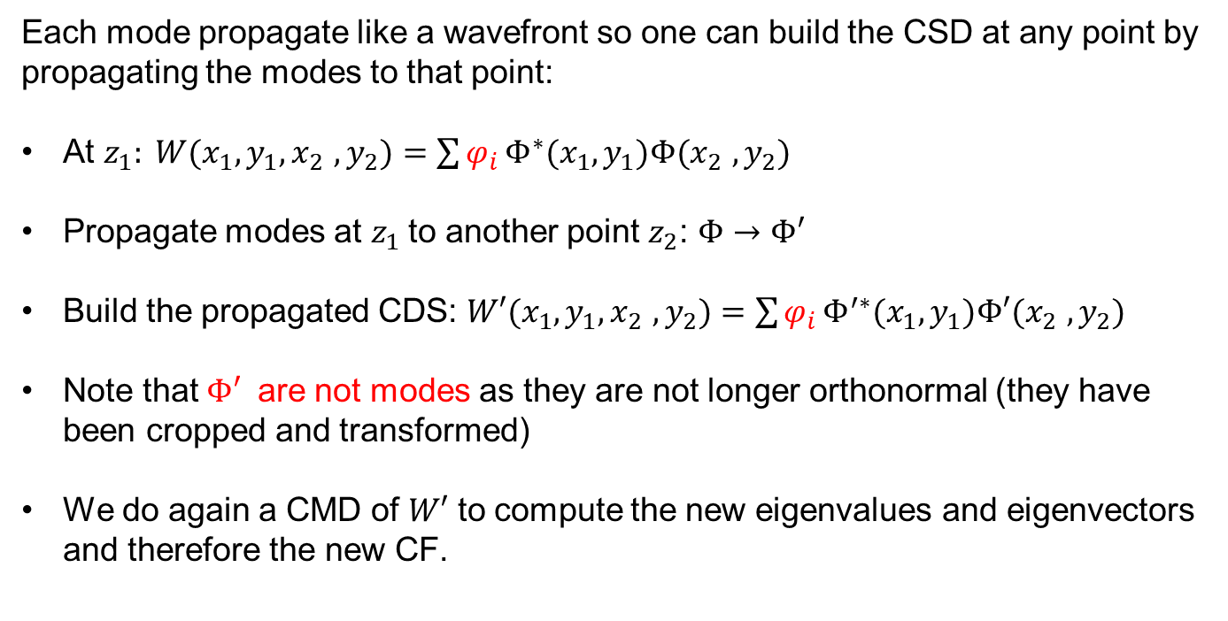
Important: A mode propagated is not longer a mode
Each mode propagate like a wavefront so one can build the CSD at any point by propagating the modes to that point:
At $z_{1}: W(x_{1},y_{1},x_{2}$ $,y_{2})=\sum{φ_{i}}Φ^{∗}(x_{1},y_{1})Φ(x_{2} ,y_{2})$
Propagate modes at $z_{1}$to another point $z_{2}$: $Φ→Φ′$
Build the propagated CDS: $W′(x_{1},y_{1},x_{2}$ $,y_{2})=\sum{φ_{i}}Φ^{′∗}(x_{1},y_{1})Φ′(x_{2} ,y_{2})$
Note that $Φ′$ are not modes as they are not longer orthonormal (they have been cropped and transformed)
We do again a CMD of $W′$ to compute the new eigenvalues and eigenvectors and therefore the new CF.

Slide 17
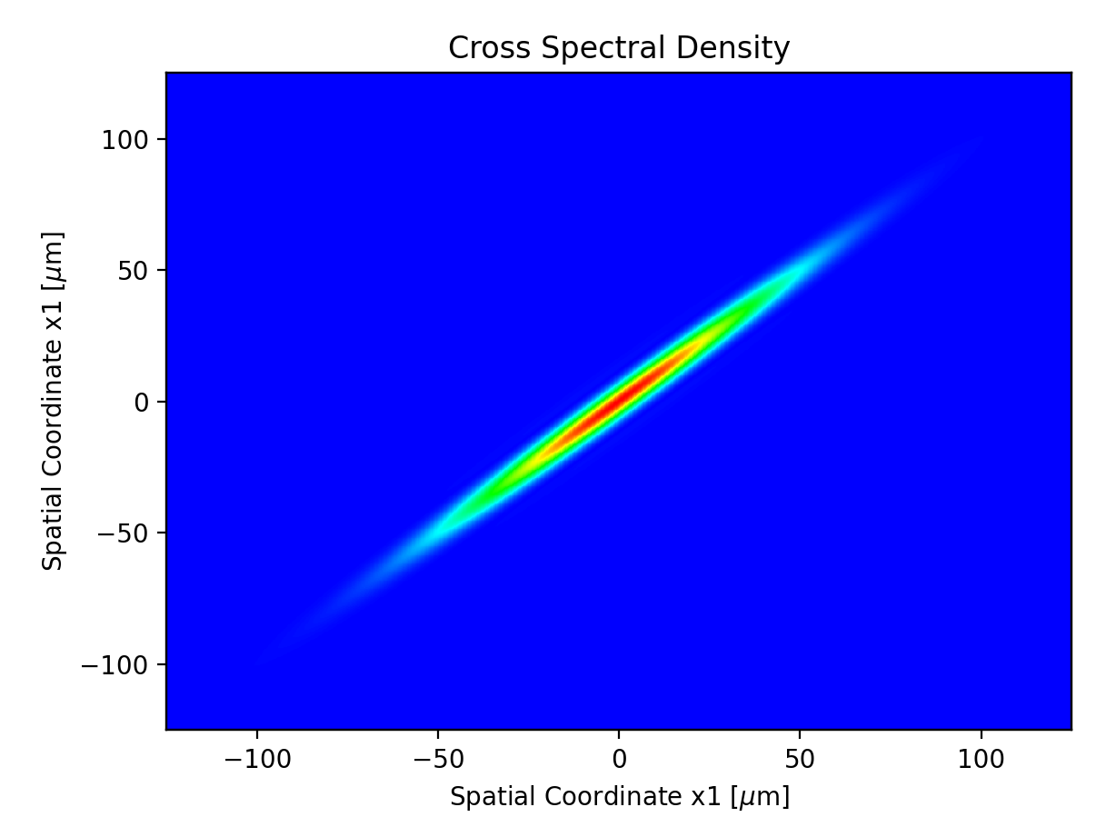
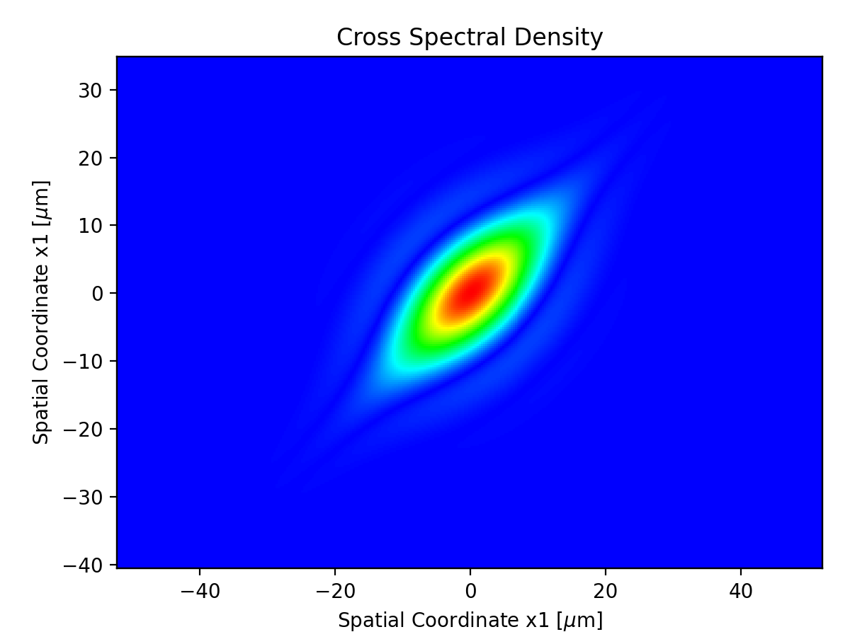
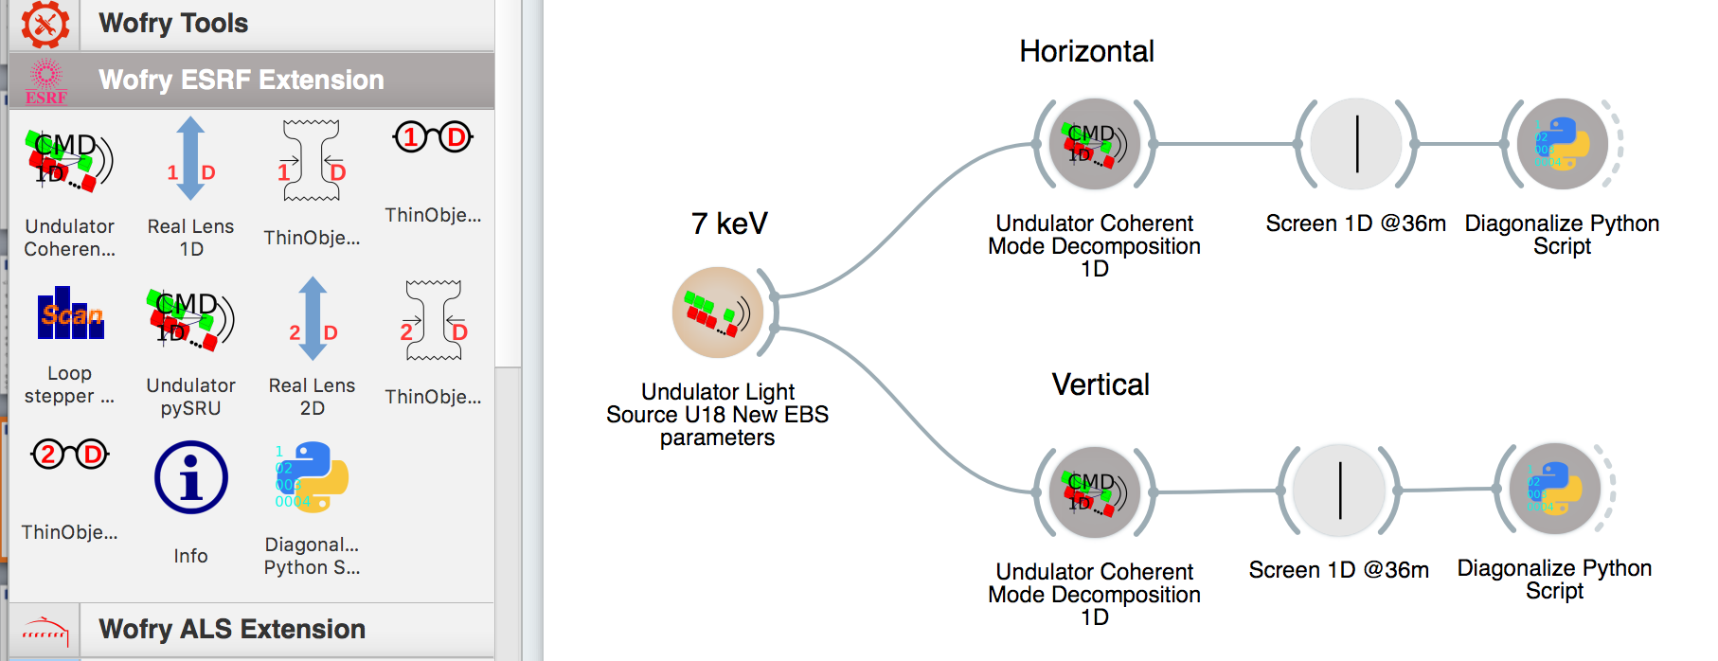
Everything is much simpler in 1D:
Horizontal W(x₁,x₂) Vertical W(y₁, y₂)
CMD WITH WOFRY (EBS U18 2.5m 7 kev)
A fast and lightweight tool for partially coherent beamline simulations in fourth-generation
storage rings based on coherent mode decomposition. J. Synchrotron Rad. 29, 1354–1367 (2022)
Sanchez del Rio, M., Celestre, R., Reyes-Herrera, J., Brumund, P. & Cammarata, M..
DOI: http://dx.doi.org/10.1107/S1600577522008736

Slide 18
WOFRY Wave Optics FRamwork in pYthon
WOFRY is the OASYS framework for waveoptics calculations.
From the software engineering point of view, it provides a generalization (or abstraction) of a software tool for wave optics, combining the component definitions from SYNED with the abstract declaration of wavefronts and propagators https://doi.org/10.1117/12.2274232, and defines a mechanism for interfacing a wave optics codes (e.g., SRW, WISE etc.) in OASYS [package: WOFRY]
From the physics point of view, it provides native implementations of simple wavefronts (e.g., plane waves, spherical waves, Gaussian sources), makes 1D coherent mode decomposition, and include free space propagators and optical elements for prototyping optical systems (in 1D and 2D). [package: WOFRYIMPL]

Slide 19
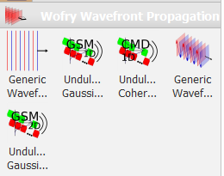
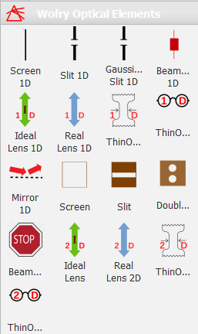
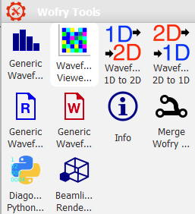
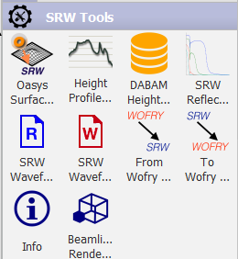
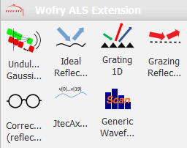
WOFRY
Sources Optical elements Tools

Slide 20
Gallery of exercises & examples (afternoon session)

Slide 21
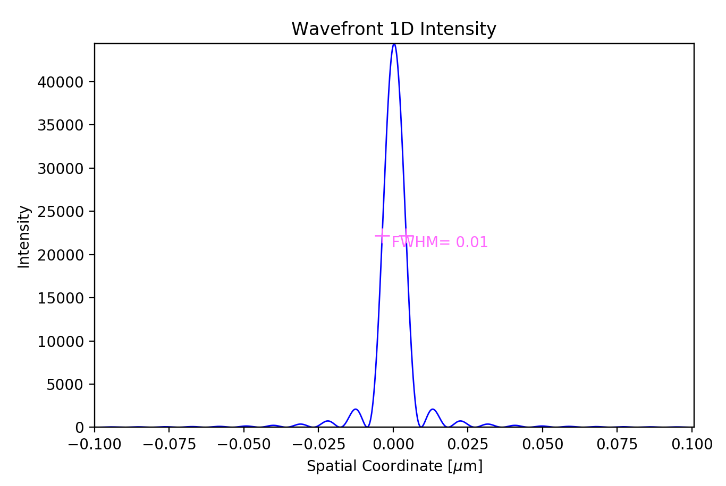
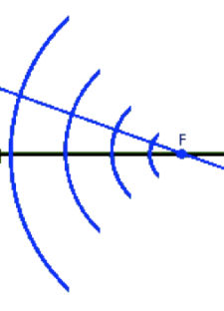
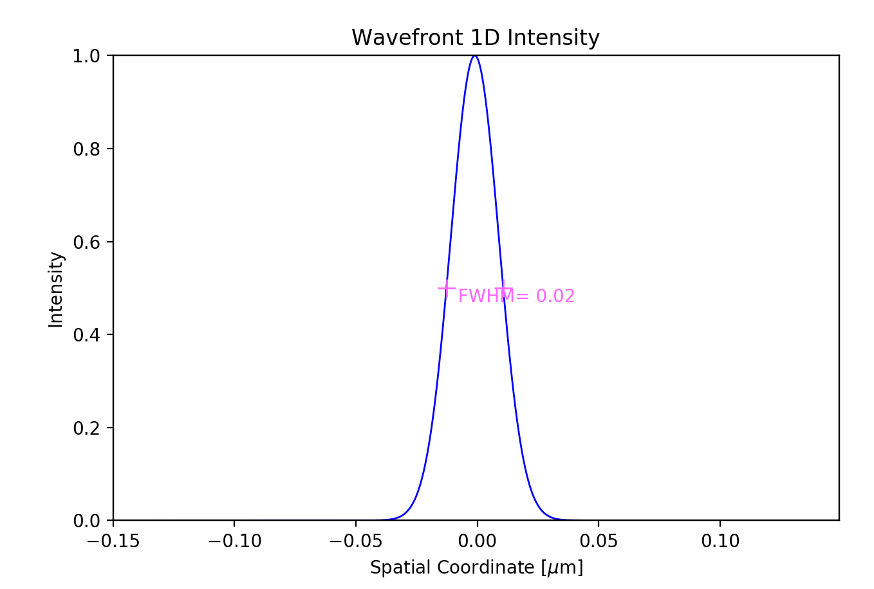
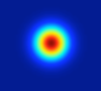
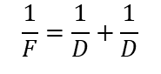
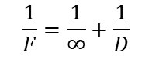
Diffraction by slits (full coherence)
Aperture=0.4 mm, Ε=17225 eV, D=5cm
Converging spherical +
Propagation (D)
Plane + Lens (F=D)+ Propagation (D)
$$\frac{1}{F}=\frac{1}{∞}+\frac{1}{D}$$
F=D
Spherical divergent+ Lens (F=D/2)+ Propagation (D)
F=D/2
$$\frac{1}{F}=\frac{1}{D}+\frac{1}{D}$$
Gaussian+ Propagation(D)+ Lens (F=D/2)+ Propagation (D)
F=D/2
21

Slide 22
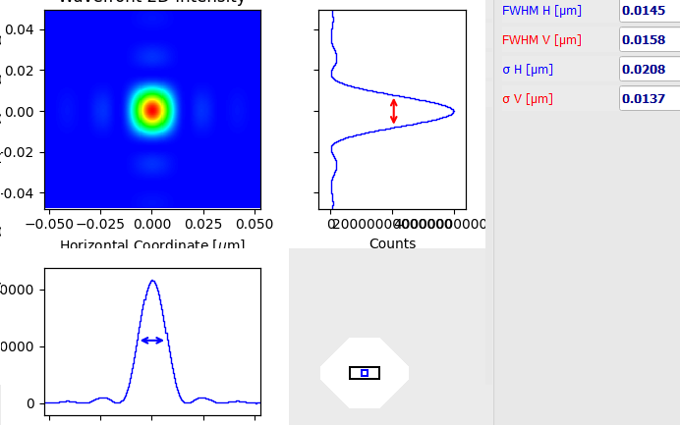
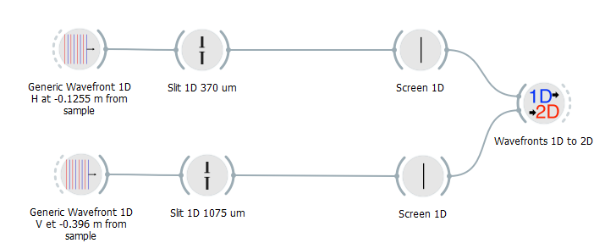
2D Oversimplified Beamline (APS-ISN)
Theoretical consideration
The diffraction by a DxD square aperture of a collapsing spherical wavefront has an intensity distribution proportional to sinc²(kDx/2f ) sinc²(kDy/2f), where k=2π/λ, x(y) is the horizontal (vertical) coordinate, and f is the distance aperture-focus (D/f is the divergence). Considering that the FWHM of sinc²(x) is approximately 2.78, one obtains FWHM=0.885 * wavelength / divergence
Size FHHM 0.0148872 x 0.016168 um

Slide 23
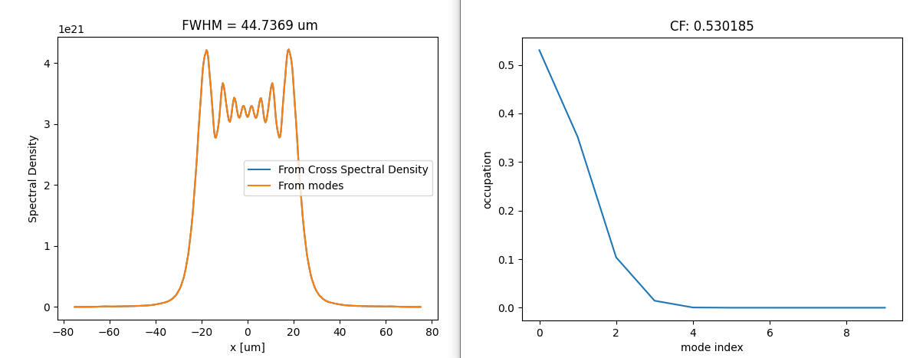
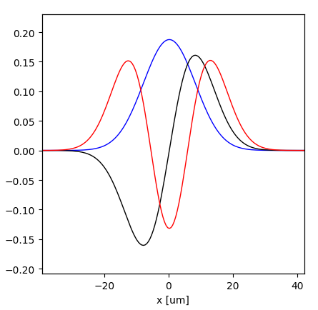
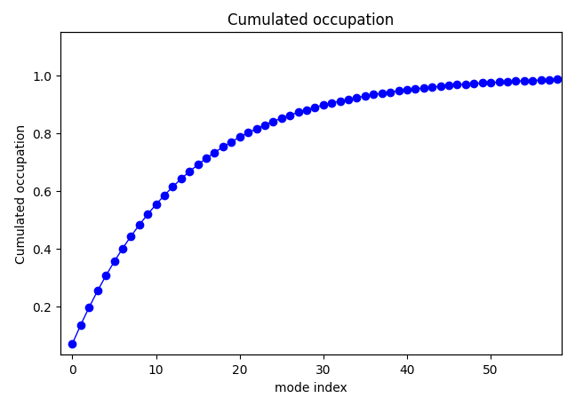





Example: Gain coherence by using a slit ESRF U17 @ 15 keV
MODEL 3
Modes Cumulated occupation
CFh=0.53
CFh=0.07
Horizontal
50x50 μm²
Vertical
Modes Cumulated occupation
CF= CFh x CFv:
Source: 0.038
Image: 0.51
CFv=0.97
CFv=0.54

Slide 24

1D model of ISN Beamline (25 keV)
CF: 14%
14 μm
CF: 38%
CF: 88%
CF: 99%
CF: 52%
4 μm
CF: 90%

Slide 25










ALS-FLEXON: CORRECTION OF THERMAL DEFORMATION WITH ADAPTIVE OPTICS
M1: 819μm
M3: 1630 μm
Sample: 3.8 μm
LN cooling Cutler et al. http://dx.doi.org/10.1107/S1600577520009522)
Water cooling
(CF ~ 0.8 with a 4 m undulator at 230 eV)
M. Sanchez del Rio et al, JSR 2020
http://dx.doi.org/10.1107/S1600577520009522

Slide 26
Gallery of results

Slide 27


EBS vs ESRF1 : Coherence fraction with COMSYL
M Glass, M Sanchez del Rio, EPL Europhysics letters (2017)
http://dx.doi.org/10.1209/0295-5075/119/34004

Slide 28

COHERENCE FRACTION MODIFICATION BY SLITS
EBS U18 L=2.5m
58% (V)
13% (H)
Sanchez del Rio, M., Celestre, R., Reyes-Herrera, J., Brumund, P. & Cammarata, M..
J. Synchrotron Rad. 29, 1354–1367 (2022)
DOI: http://dx.doi.org/10.1107/S1600577522008736

Slide 29














ALS-U U38 source 806 eV (COMSYL CMD)
m=19 (ice crystal)
m=32 (mask)
m=43 (clock)
m=0
m=0
m=1
m=2
m=3
m=4
m=5
m=6
m=7
m=8
m=9

Slide 30

Beam focus modifications by cropping partially coherent X-ray beams
p₀
p₁
Sanchez del Rio, M., Celestre, R., Reyes-Herrera, J., Brumund, P. & Cammarata, M.
EPL 140 55001 (2022) DOI https://doi/org/10.1209/0295-5075/aca4ef

Slide 31




Singularities in the phase of the cross spectral density
COMSYL 1.4-m-long U18 EBS (6 GeV, 147 pm rad emittance)
Eo = 17.226keV (K =0.411)
Intensity (spectral density)
First coherence mode
Fix a point
D Paganin, M Sanchez del Rio, Phys Rev A (2019)
http://dx.doi.org/10.1103/PhysRevA.100.043813

Slide 32

Propagated BEAM: DIFFERENT TYPES OF SINGULARITIES APPEAR
Domain walls
Coherence
vortices
a,b, g
Vortex-antivortex hi,jk
Halo of CSD speckle
D Paganin, M Sanchez del Rio, Phys Rev A (2019)
http://dx.doi.org/10.1103/PhysRevA.100.043813

Slide 33
Thank you!
OASYS Workspaces for exercises and examples: https://drive.google.com/drive/folders/1tRkhSphrNybnI_-rflk7bG2dUEJ9CVuZ?usp=drive_link

Slide 34
Extra slides

Slide 35


Propagators
Fresnel
Fresnel (convolution)
Integral
Fresnel Zoom
Fresnel Zoom Scaled
1D
2D

Slide 36


Zoom Propagator
G. Pirro, Master Thesis (2017)
https://github.com/oasys-kit/documents/blob/master/zoom_propagator_pirro_thesis.pdf

Slide 37




SIMPLE CASE: 1D Gaussian SHELL-MODEL
Both intensity (Spectral Density) and correlation (Spectral Degree of Coherence) are Gaussians
σ_{I}>>σ_{μ} the source is mostly incoherent (quasi homogeneous)
σ_{I}<<σ_{μ} is mostly coherent
I
I
Eigenvalues
Eigenfunctions
(Hermite-Gaussian modes)
Magic property: Propagation invariance
In the first mode (Gaussian) :
In 2D (H x V)
2D Hermite-Gaussian or
TEM_{nm} modes

Slide 38






The spectrum of coherent modes
Eigenvalues
Mode occupation:
Coherent: β>>
Coherent fraction:
incoherent
β<<
In general we cannot apply Gaussian Shell-model to synchrotron

Slide 39


Coherence – Longitudinal and transversal
We need at least TWO waves for defining coherence parameters
Longitudinal or Temporal Coherence: depends on the monochromaticity of the source (describes the correlation or predictable relationship between waves observed at different moments in time)
Transversal Coherence: Depends on the source geometry (correlation between waves at different points in space)

